Slide 1

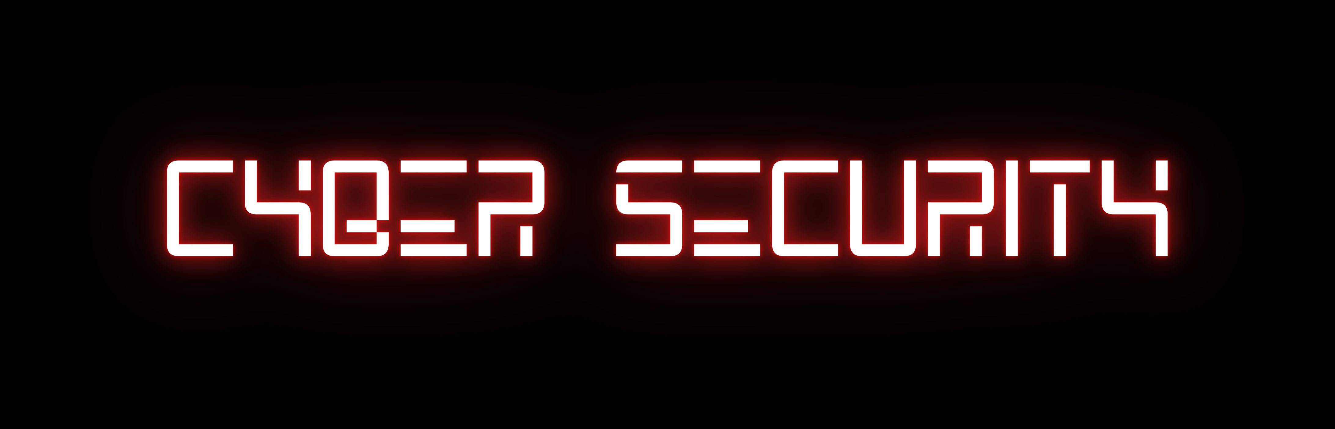
YOURFIRSTLINEOFDEFENSEINTHEDIGITALWORLD
by - BUVANESH

Slide 2

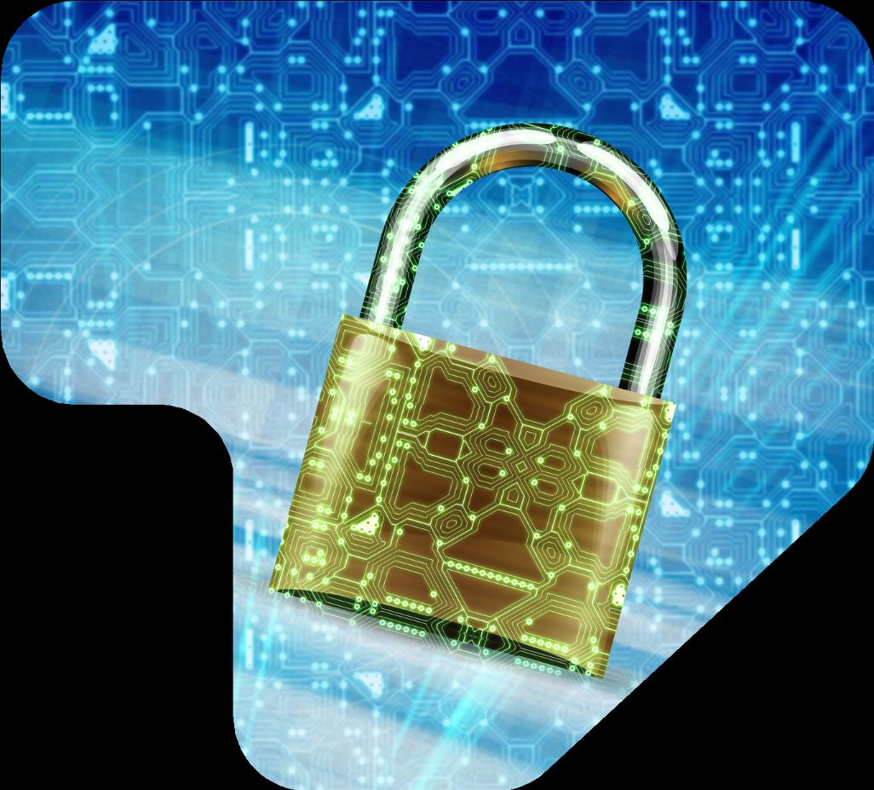
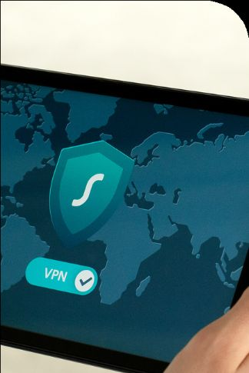
LARANA,INC.
Home
About
Contact
WHYCYBERSECURITYMATTERS
Intoday’sdigitalage,protectingpersonalandbusinessinformationiscrucial.Cyber threatsevolveconstantly,requiringindividualsandorganizationstostayvigilantandproactive.
Scopeof Cybersecurity
Cybersecurity encompasses protectingnetworks,systems, and datafromunauthorized access,ensuringconfidentiality,integrity,andavailabilityinanever-expandingdigital world.

Slide 3
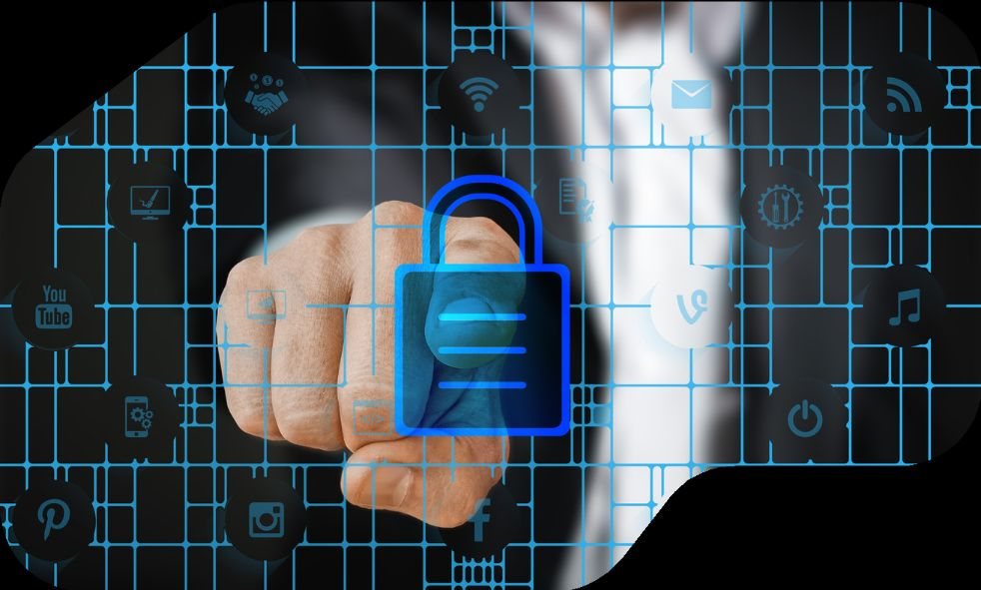
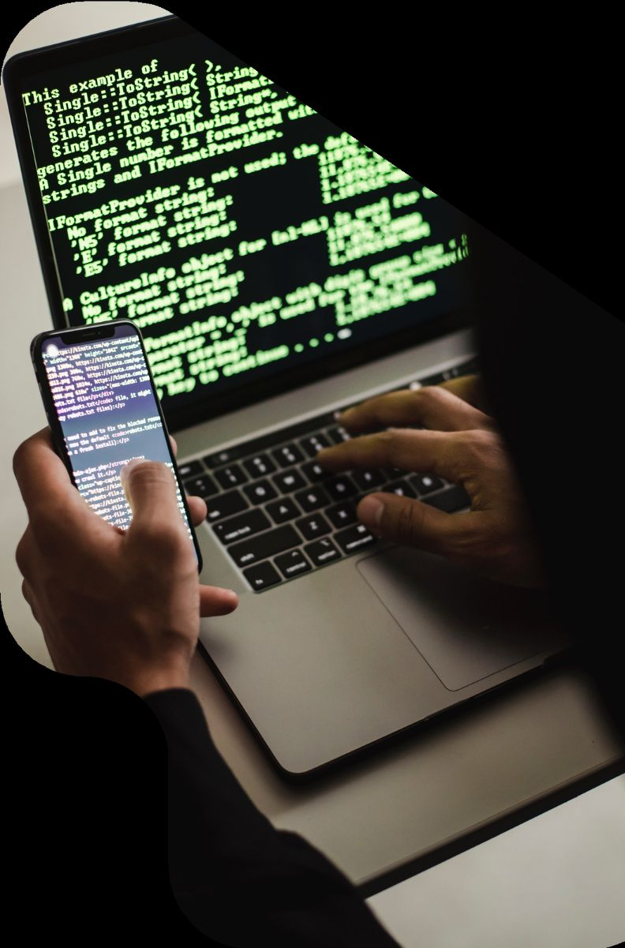
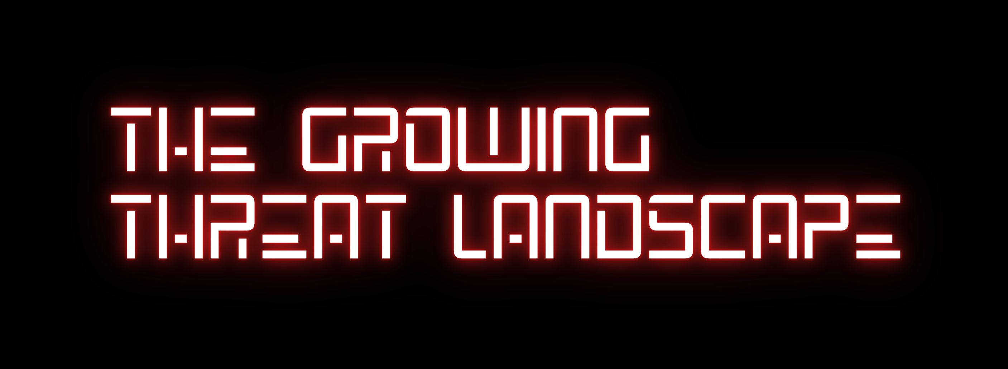
LARANA,INC.
Home
About
Contact
RISINGCYBERTHREATSANDTHEIRIMPACT
RiseofCyberattacks
Cybercriminalsareemployingadvanced techniques suchas phishing,ransomware,andsocialengineeringtoexploit vulnerabilitiesandstealsensitiveinformation fromindividuals andbusinesses.
IncreasedDigitalDependency
Withtherapidadoptionof cloudcomputing,IoTdevices,and onlinetransactions, the attacksurfaceforcyberthreatscontinues toexpandatanalarmingrate.
ImpactonBusinesses&Individuals
Databreachescancausefinanciallosses,reputationaldamage, andlegalconsequences,makingcybersecurityanecessity ratherthananoption.

Slide 4
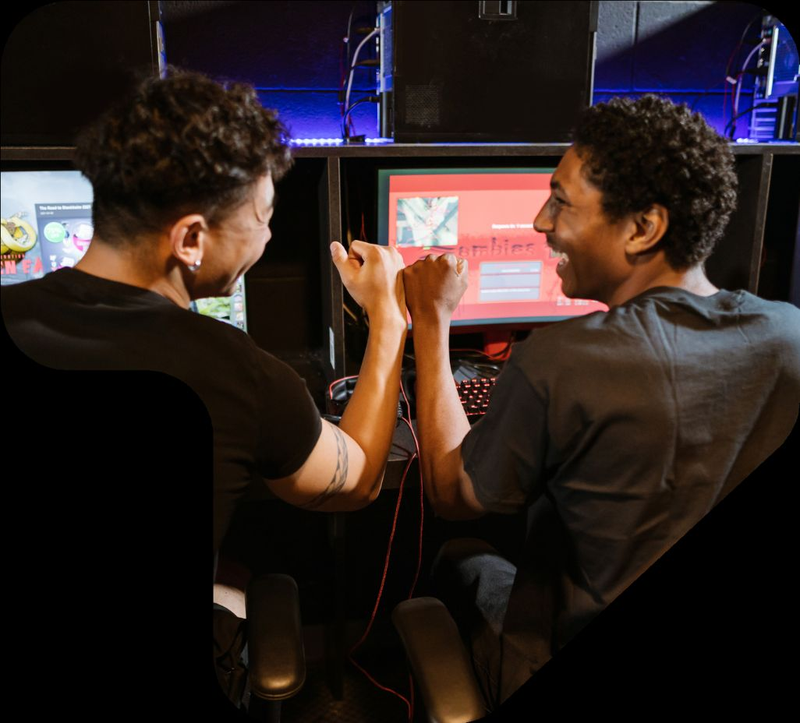
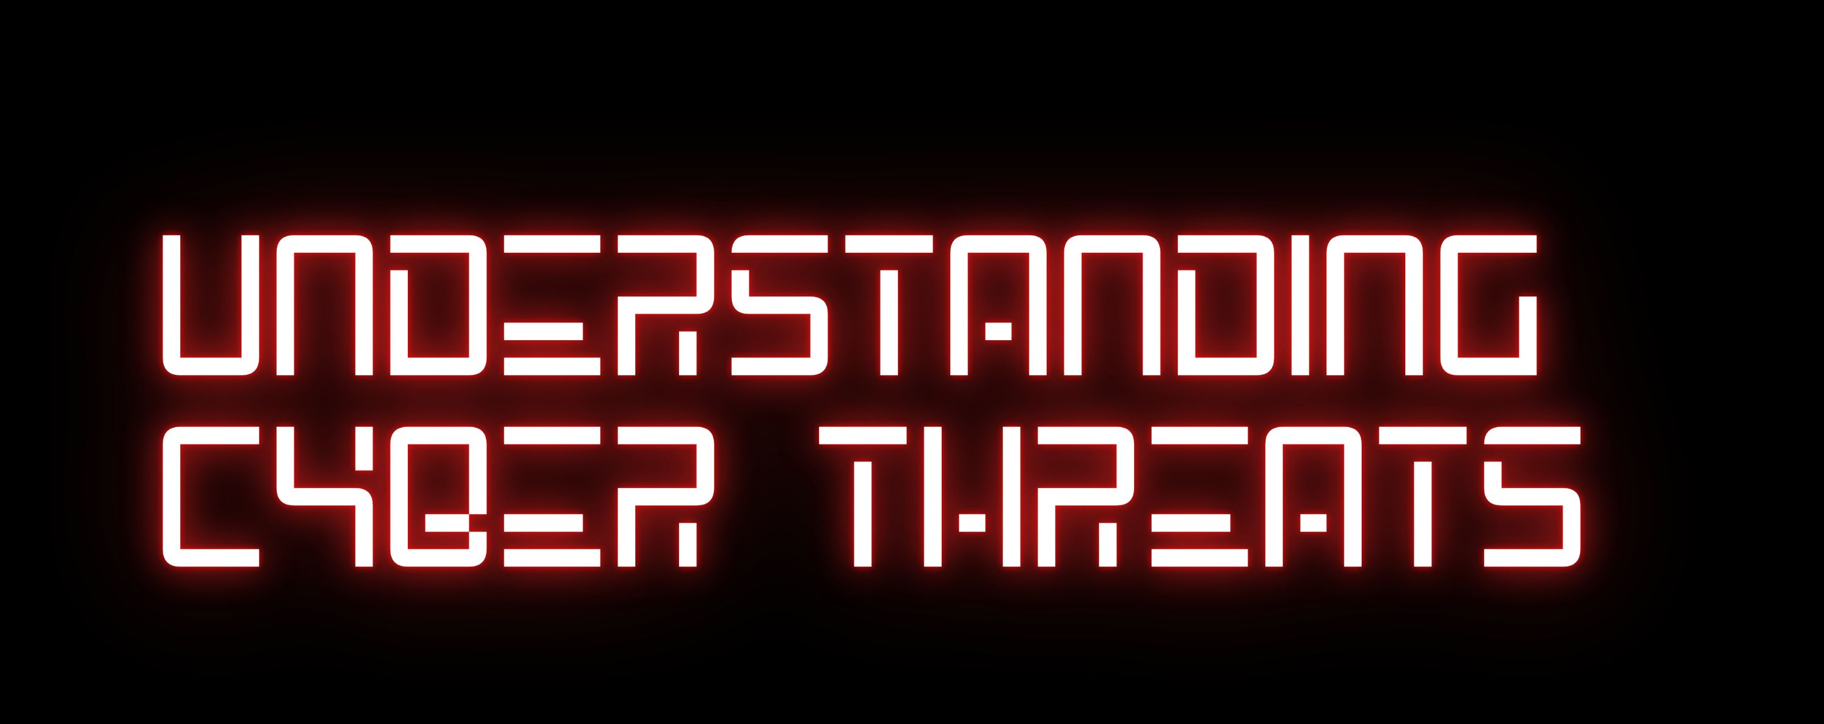


LARANA,INC.
Home
About
Contact
TYPESOFCYBERTHREATSANDTHEIR CONSEQUENCES
Cyberthreatscome in manyforms,including malware, phishing, ransomware, andinsiderthreats.Attackersexploitsystemweaknessesand humanerrorstogainunauthorizedaccess,disruptoperations,or stealdata. Recognizingthesethreatsisessentialinpreventingsecuritybreaches and ensuringonlinesafetyinbothpersonalandprofessionaldigital environments.

Slide 5
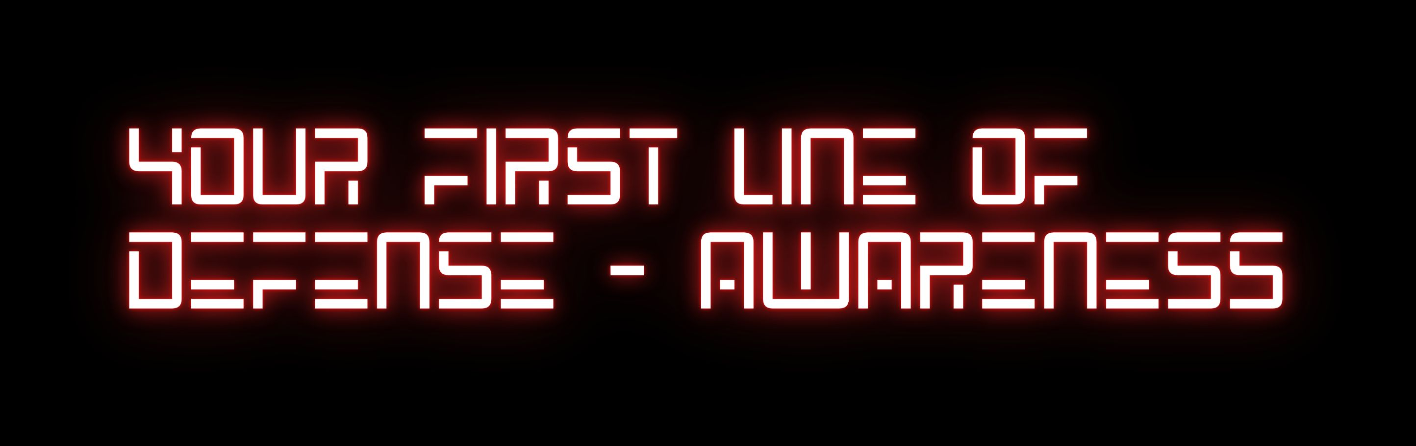
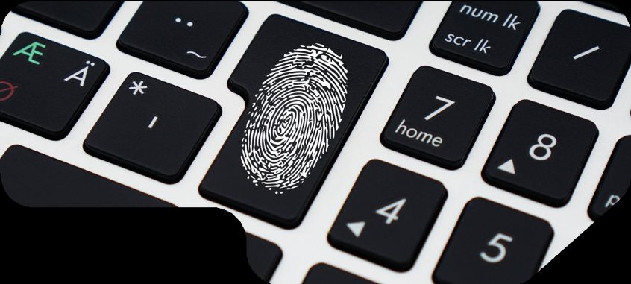
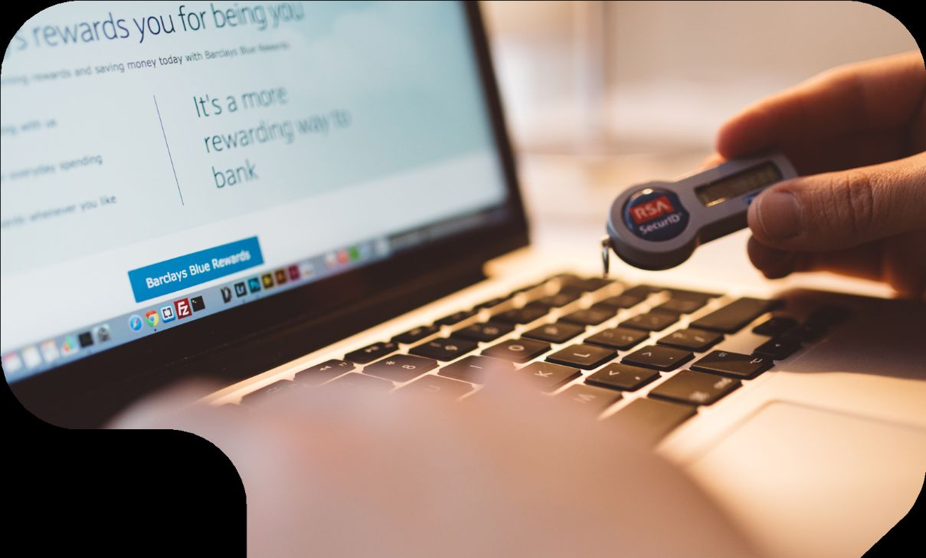
LARANA,INC.
Home
About
Contact
BUILDINGASECURITY-CONSCIOUSMINDSET
SocialEngineeringAwareness
Understandingtacticslikephishingandpretextinghelpsusersavoid manipulationthatcouldleadtodatabreachesorsecuritycompromises.
EducatingUsers
Awarenessprogramsandcybersecuritytrainingempowerindividualsto recognizecyberthreatsandadoptsecureonlinepracticestoprevent potentialattacks.

Slide 6
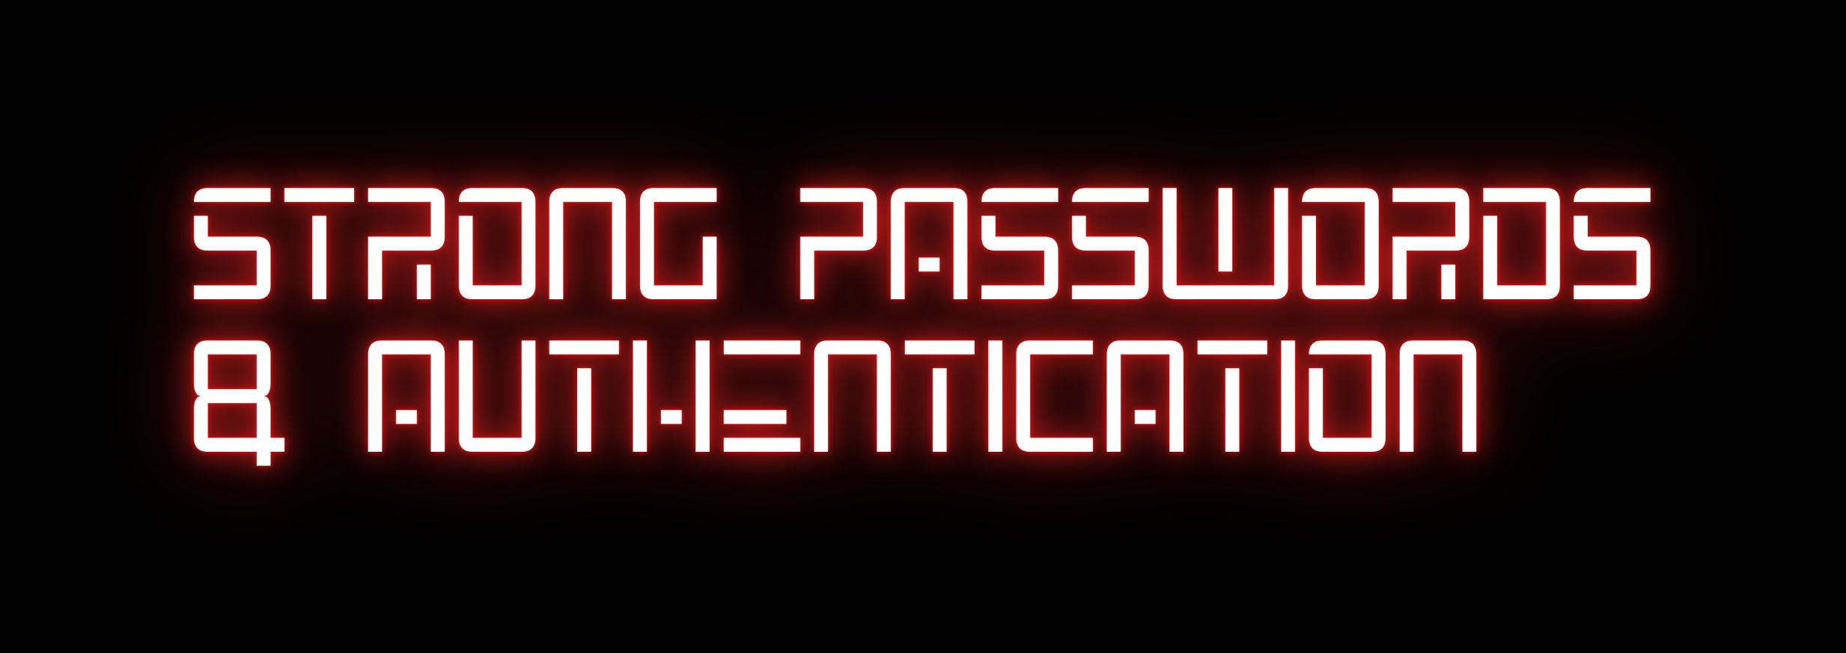
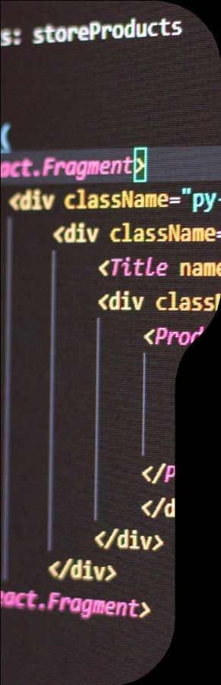
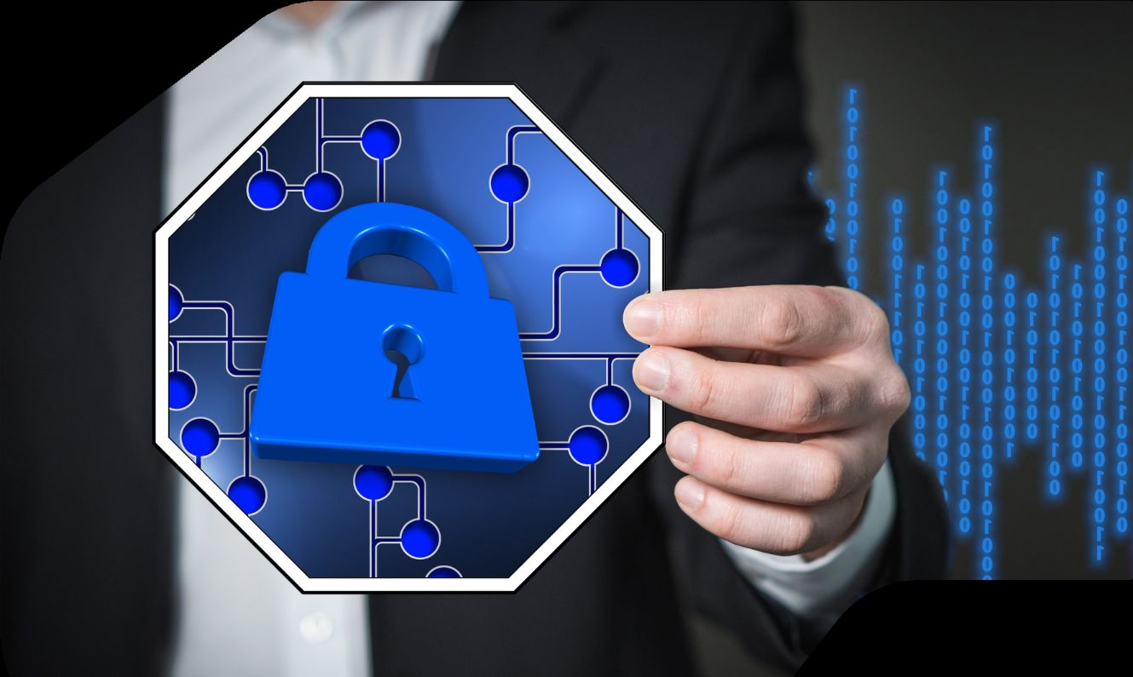

LARANA,INC.
Home
About
Contact
ENHANCINGACCESSSECURITY
ComplexPasswords
Strongpasswordswithamixofletters,numbers,and symbolsreducetheriskofunauthorizedaccess.rity.
Multi-FactorAuthentication(MFA)
Addingextraauthenticationlayers,like biometrics orOTPs, enhancessecurityagainstcredentialtheft.
RegularUpdates
Changingpasswordsfrequentlyandavoidingreuse minimizesexposureincaseofdataleaks.
PasswordManagers
Usingpasswordmanagershelpssecurelystoreandmanage complexcredentialswithoutcompromisingsecurity.

Slide 7
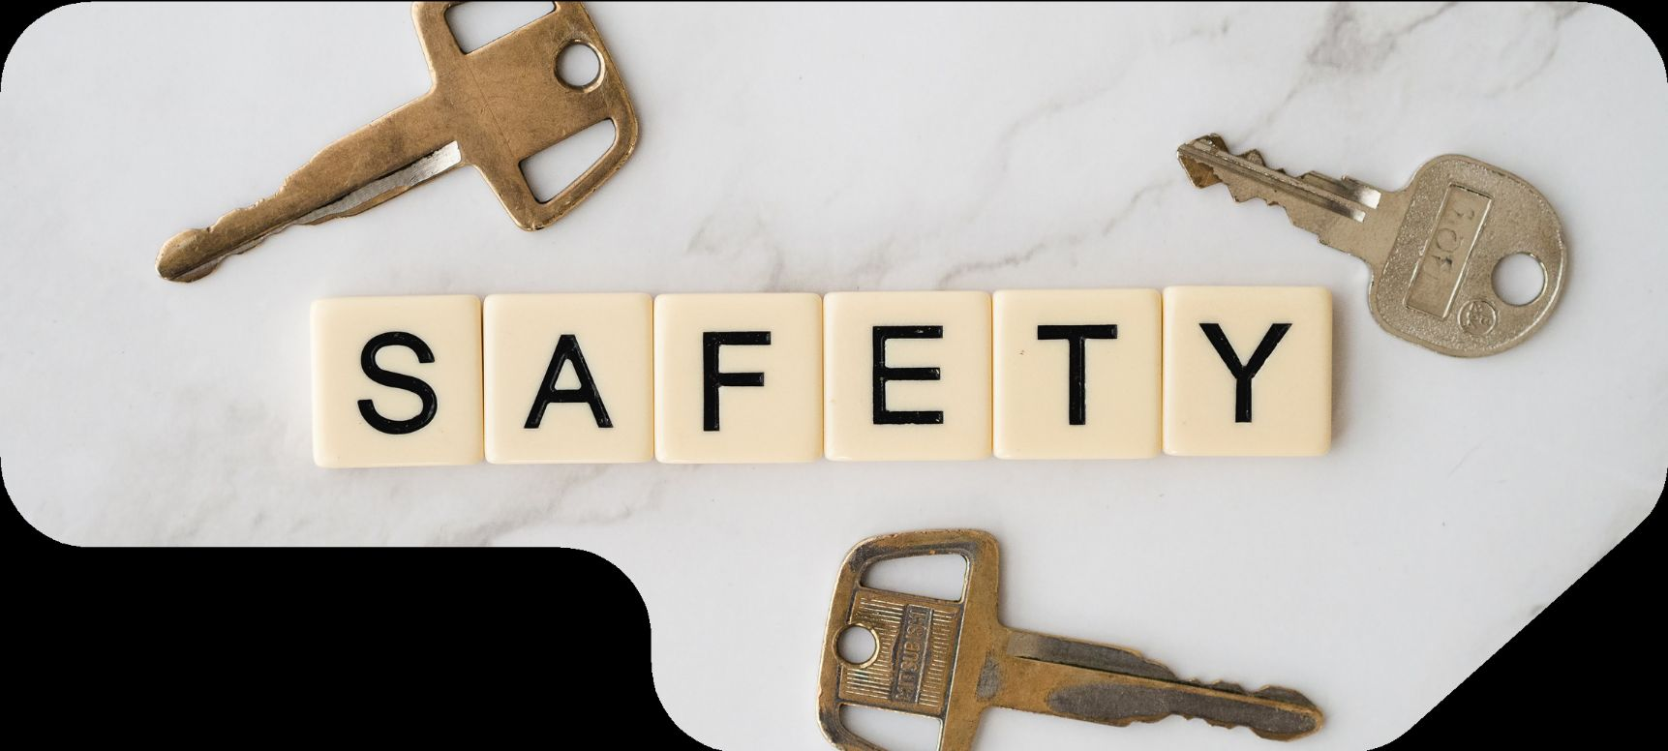
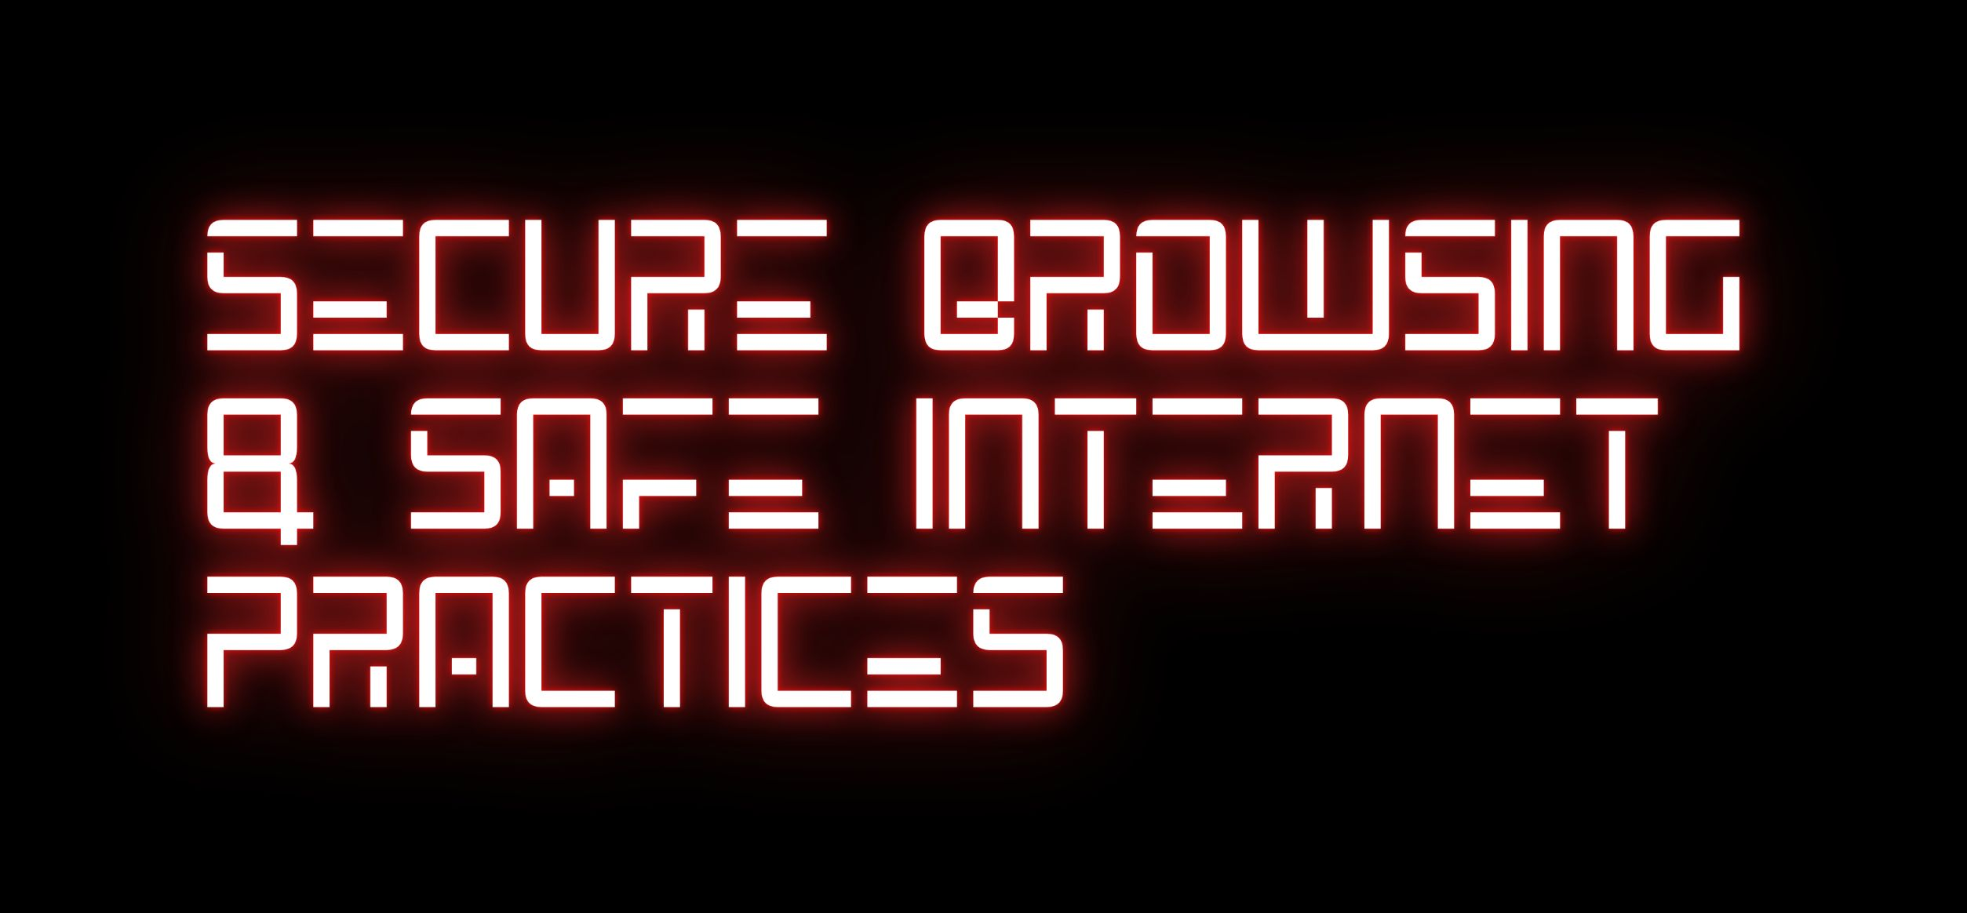
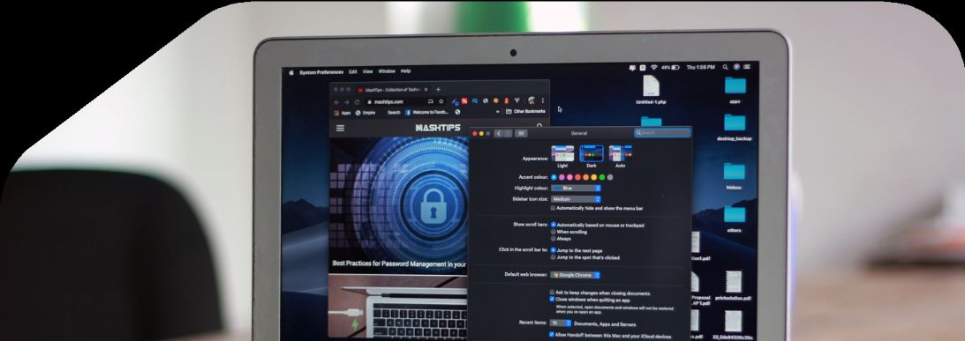
LARANA,INC.
Home
About
Contact
HOWTOSTAYSAFEONLINE
RecognizingSuspiciousLinks
Avoidclickingunknownlinksordownloadingunverifiedfilestoprevent malwareinfectionsandphishingattacks.
HTTPSandSecureWebsites
EnsuringwebsitesuseHTTPSencryptionprotectssensitive datafrom interceptionandcybereavesdropping.
AvoidingPublicWi-FiRisks
Publicnetworksarevulnerabletocyberthreats;usingVPNsand securedconnectionspreventsunauthorizedaccesstopersonaldata.

Slide 8
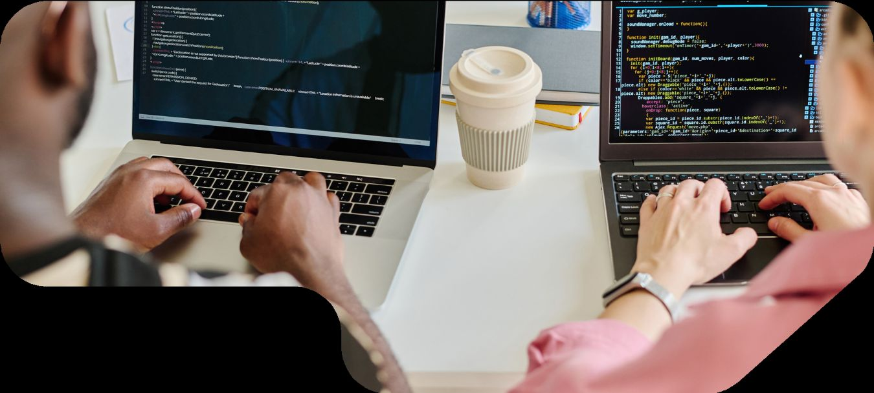
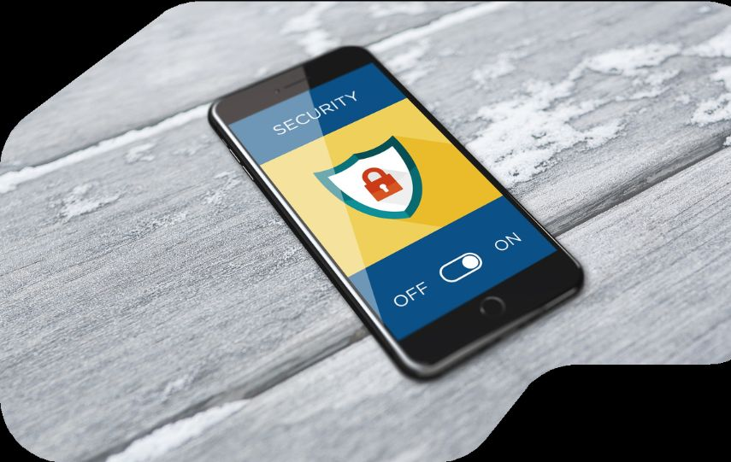
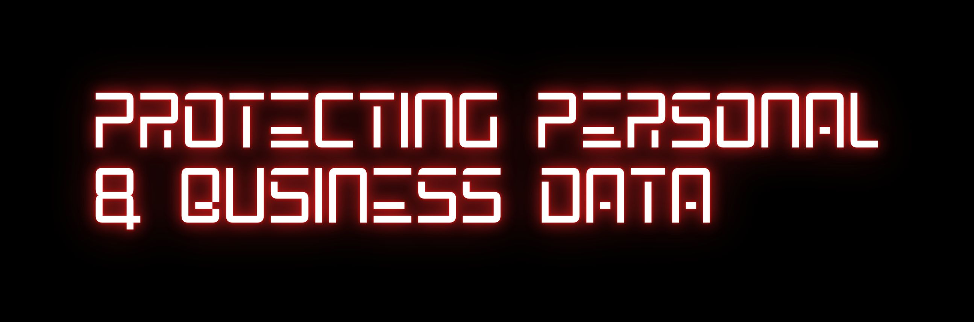
LARANA,INC.
Home
About
Contact
SAFEGUARDING CRITICALINFORMATION
Data protectioninvolvesimplementingstrongencryption, securebackups,and controlledaccessmeasures.
Businessesshouldhavesecuritypolicies in place,while individualsmustpracticesafestoragehabits.
Cybersecurityisnotjustaboutpreventingattacksbutalso mitigatingdamageandensuringdata recoverywhen breachesoccur.

Slide 9
EmployeeTraining
IMPLEMENTINGSECURITY MEASURESINTHEWORKPLACE
Regulartrainingreducesthe riskofinsiderthreats andenhancesoverallsecurity awareness.
SecureNetworkAccess
UsingVPNsandfirewallsprotectscompany data fromunauthorizedaccess.
Device Security
Keeping work devicesupdatedandpatched ensuresvulnerabilitiesare minimized.
EmailSecurity
Avoidingsuspiciousattachmentsandlinks preventsphishing attempts anddataleaks.

Slide 10
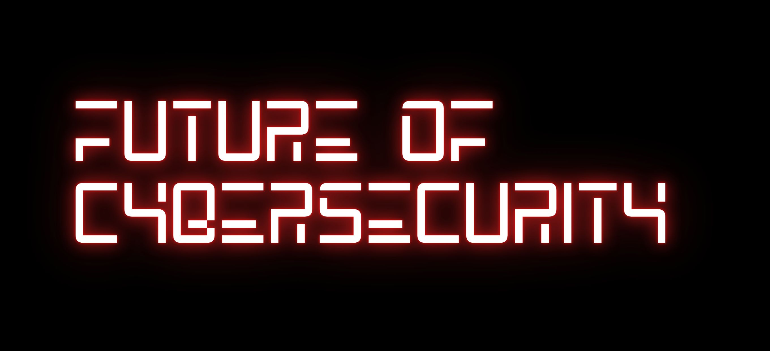
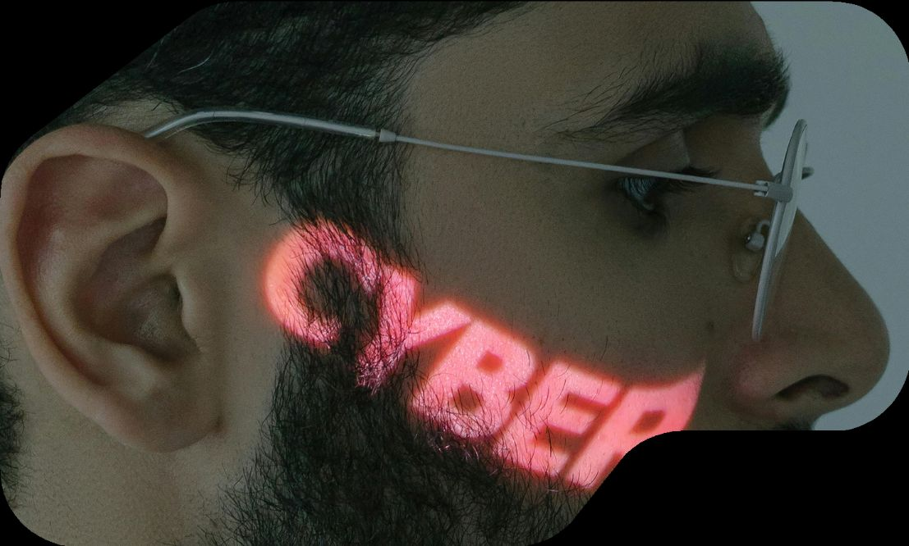
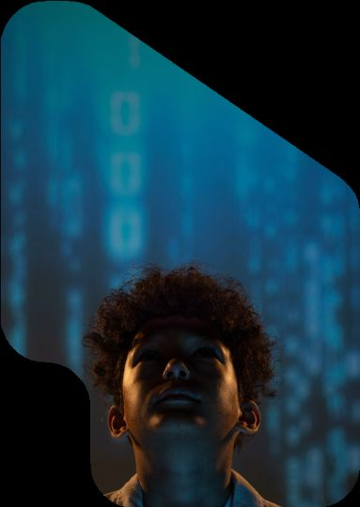
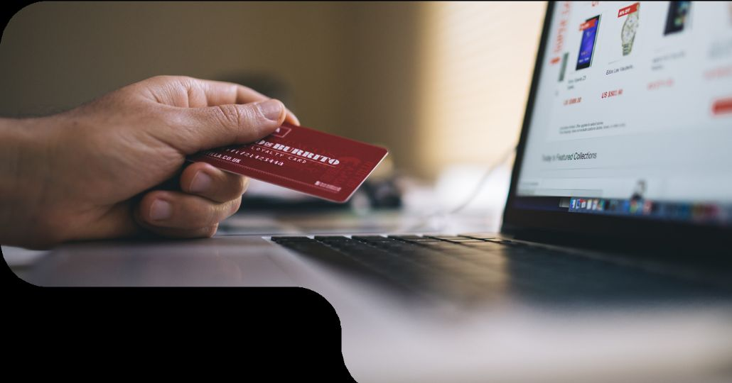
LARANA,INC.
Home
About
Contact
THEROADAHEADIN CYBERSECURITY
Cybersecuritywillcontinueevolvingto counter advancedcyberthreats.AI-driven securitymeasures,threatintelligence,and blockchainsecuritysolutionswillplaya crucialroleinprotecting digitalassets.As attackers refinetheirtactics,cybersecurity professionalsmuststayaheadwithadaptive defensesand innovativestrategies.
Asnewtechnologiesemerge,security challengeswillalsogrow.Organizations mustinvestinrobustsecurityinfrastructures, regulatorycompliance, andworkforce training.Collaborationbetween governments,businesses,andcybersecurityexpertsiskeytocreatinga saferdigitalfuture.

Slide 11


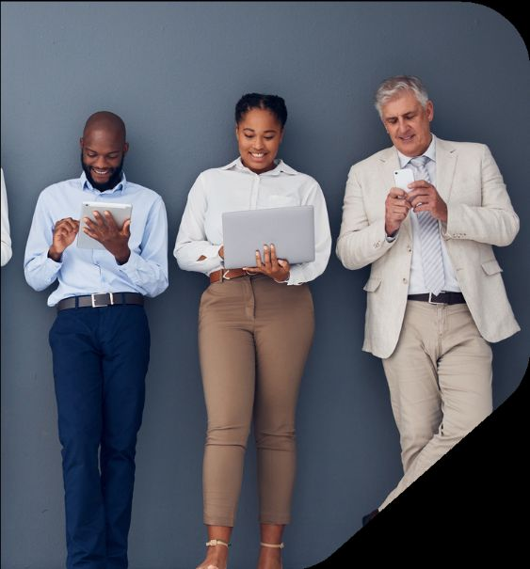




LARANA,INC.
Home
About
Contact
GETINTOUCH
Thankyouforyourtime!Stayvigilant,secureyourdata, andbeproactive incybersecurity.Forfurtherquestions or consultations,contact usat
+123-456-7890
WWW.REALLYGREATSITE.COMHELLO@REALLYGREATSITE.COM
123ANYWHEREST.,ANYCITY,ST12345

